Slide 1
Getting data into R

Slide 2
Data structures

Slide 3
Why we’re starting here
“Bad programmers worry about the code. Good programmers worry about data structures and their relationships.”
— Linus Torvalds

Slide 4

HTRU2

Slide 5
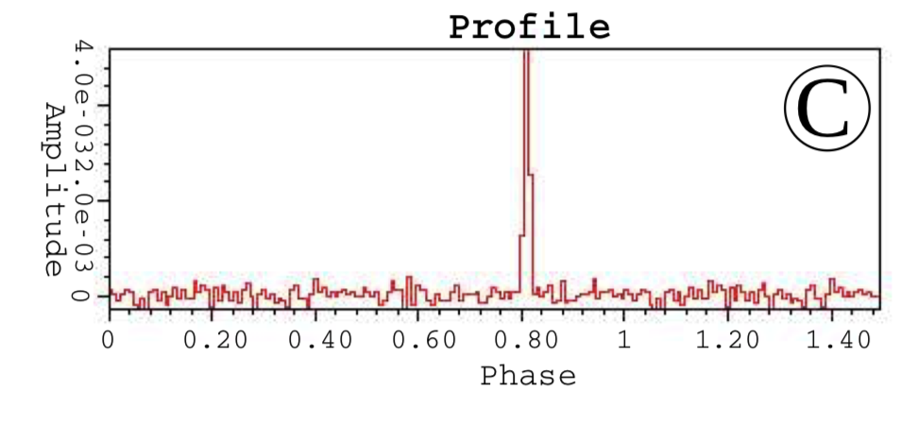
Pulsar emission profiles from https://arxiv.org/pdf/1603.05166.pdf

Slide 6
The data
Measurements
1. Mean of the integrated profile
2. Standard deviation of the integrated profile
3. Excess kurtosis of the integrated profile
4. Skewness of the integrated profile
5. Mean of the DM-SNR curve
6. Standard deviation of the DM-SNR curve
7. Excess kurtosis of the DM-SNR curve
8. Skewness of the DM-SNR curve
9. True or false pulsar (human-verified)

Slide 7
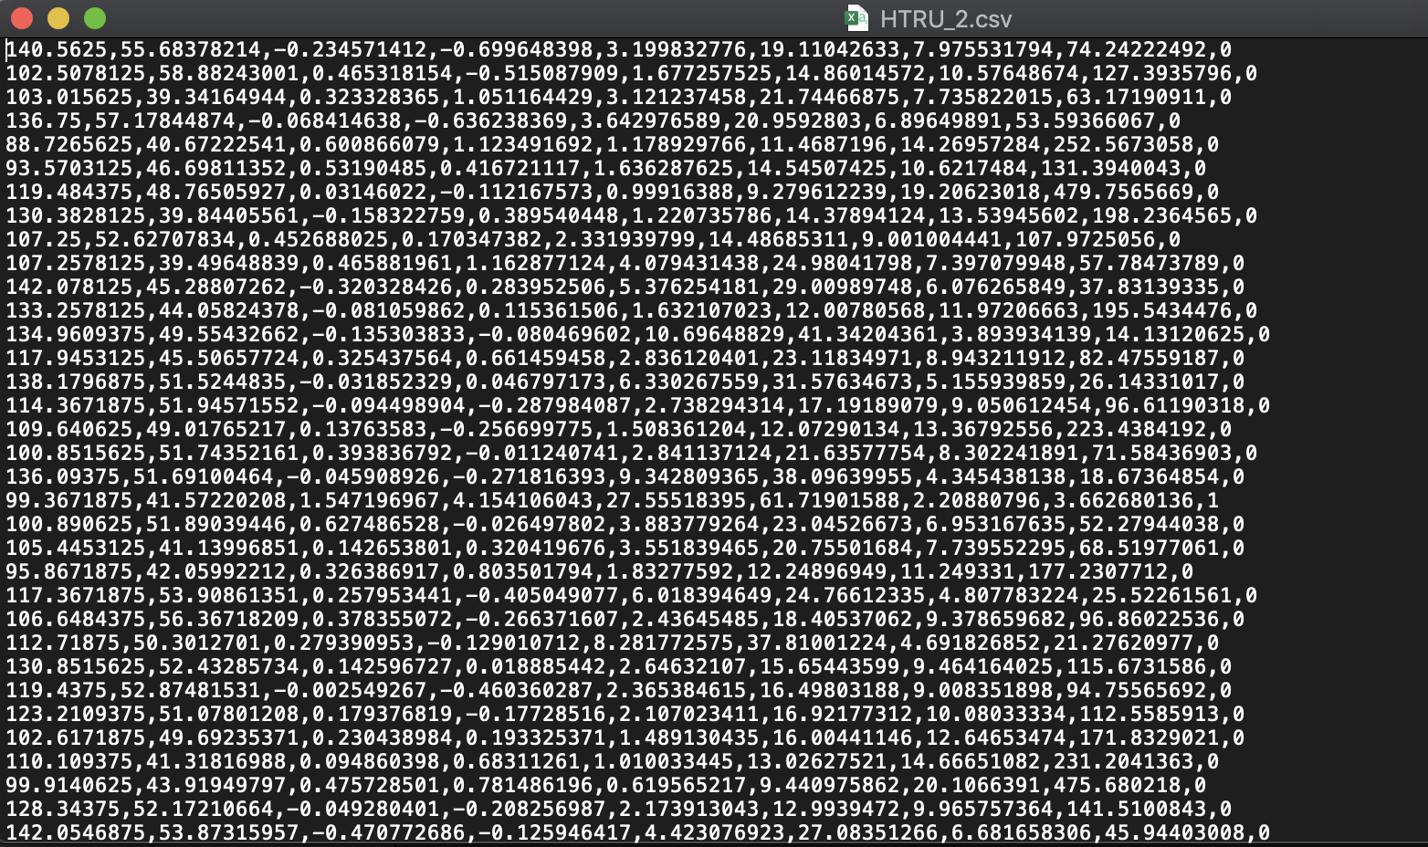
The data file

Slide 8
Downloaded from: https://archive.ics.uci.edu/ml/machine-learning-databases/00372/HTRU2.zip

Slide 9
Where do we go from here?

Slide 10
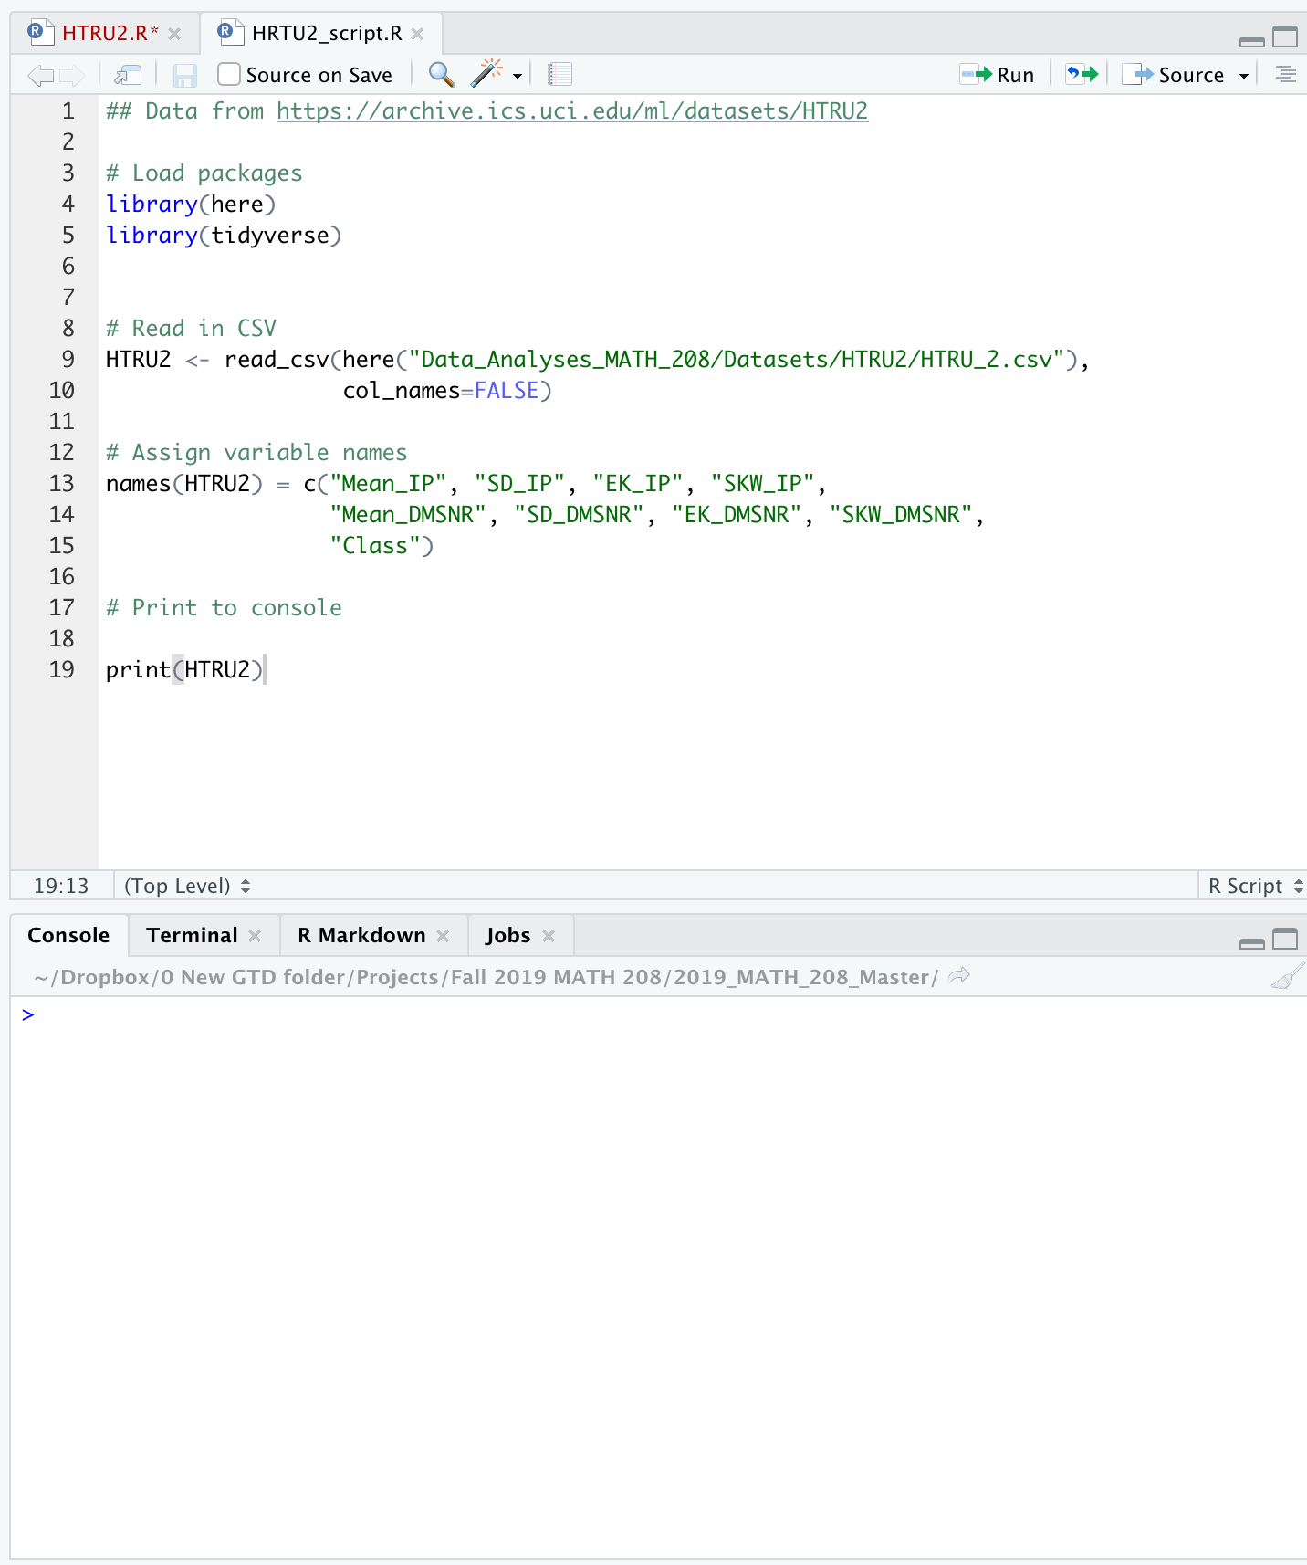
First tip: work in scripts

Slide 11
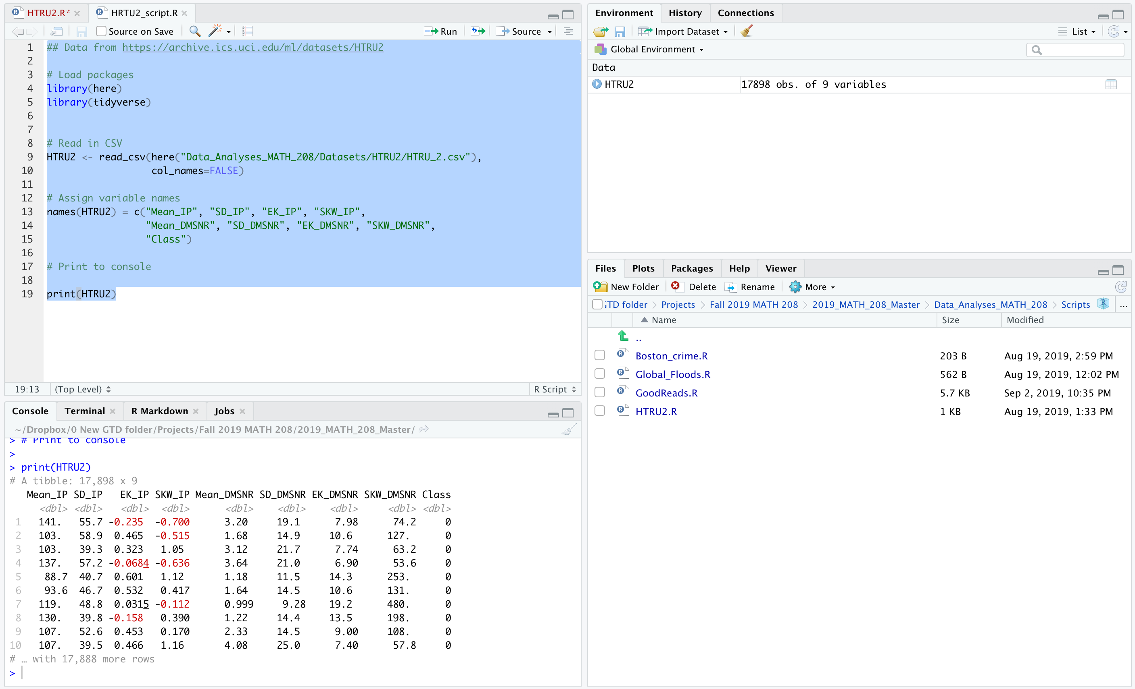
Results from running code

Slide 12
What is HTRU2?
# Read in the CSV HTRU2 <- read_csv( here("Data_Analyses_MATH_208/Datasets/HTRU2/HTRU_2.csv"), col_names=FALSE) # Name the variables names(HTRU2) = c("Mean_IP", "SD_IP", "EK_IP", "SKW_IP", "Mean_DMSNR", "SD_DMSNR", "EK_DMSNR", "SKW_DMSNR", "Class")
class(HTRU2)
[1] "spec_tbl_df" "tbl_df" "tbl" "data.frame"

Slide 13
The basics

Slide 14
The vector
Lengths_A <- c(52,51,60,64,69,74,78,84,86,96,104,112,118,125,132,135) mode(Lengths_A)
[1] "numeric"
Lengths_A[1]
[1] 52
Lengths_A[1] <- 53 Lengths_A[1]
[1] 53

Slide 15
The vector
basic = c(1,2,3) basic[5] = 5 basic
[1] 1 2 3 NA 5

Slide 16
The vector
author_list = c("J.K. Rowling", "Stephen King","Michael Lewis", "Toni Morrison","David McCullough") mode(author_list)
[1] "character"
boolean_vec = c(TRUE,FALSE,TRUE) mode(boolean_vec)
[1] "logical"

Slide 17
Operators
Lengths_A
[1] 53 51 60 64 69 74 78 84 86 96 104 112 118 125 132 135
Lengths_A + rep(1,16)
[1] 54 52 61 65 70 75 79 85 87 97 105 113 119 126 133 136
1:9
[1] 1 2 3 4 5 6 7 8 9

Slide 18
Recycling vectors
Lengths_A / rep(2.54,16)
[1] 20.86614 20.07874 23.62205 25.19685 27.16535 29.13386 30.70866 [8] 33.07087 33.85827 37.79528 40.94488 44.09449 46.45669 49.21260 [15] 51.96850 53.14961
Lengths_A / 2.54
[1] 20.86614 20.07874 23.62205 25.19685 27.16535 29.13386 30.70866 [8] 33.07087 33.85827 37.79528 40.94488 44.09449 46.45669 49.21260 [15] 51.96850 53.14961
c(1,2,3,4)+c(3,5)
[1] 4 7 6 9

Slide 19
Functions and Methods

Slide 20
Examples of functions
Function name | Argument | Action
c | Vector elements | Creates vector
rep | times/each/length.out | Replicates vector
seq.int | from/to/by/length.out/along.with | Creates sequence of integers
is.vector | Vector/mode | Returns TRUE if
atomic vector

Slide 21
More examples of functions with differing arguments
sum(c(3,5,NA))
[1] NA
sum(c(3,5,NA),na.rm=T)
[1] 8
sum(c(3,5,7),c(1,1,1))
[1] 18

Slide 22
Methods
args(mean)
function (x, ...) NULL
args(mean.default)
function (x, trim = 0, na.rm = FALSE, ...) NULL
methods("mean")
[1] mean,ANY-method mean,Matrix-method [3] mean,sparseMatrix-method mean,sparseVector-method [5] mean.Date mean.default [7] mean.difftime mean.IDate* [9] mean.POSIXct mean.POSIXlt [11] mean.quosure* see '?methods' for accessing help and source code

Slide 23
Moving beyond atomic vectors

Slide 24
Generic vectors
X <- matrix(1:9,nrow=3,ncol=3) X
[,1] [,2] [,3] [1,] 1 4 7 [2,] 2 5 8 [3,] 3 6 9
class(X)
[1] "matrix"
mode(X)
[1] "numeric"

Slide 25
Generic vectors
attributes(X)
$dim [1] 3 3
dim(X)
[1] 3 3

Slide 26
Subscripting matrices
X
[,1] [,2] [,3] [1,] 1 4 7 [2,] 2 5 8 [3,] 3 6 9
X[2,1]
[1] 2
X[4]
[1] 4

Slide 27
Operators for matrices
X %*% t(X)
[,1] [,2] [,3] [1,] 66 78 90 [2,] 78 93 108 [3,] 90 108 126
X * t(X)
[,1] [,2] [,3] [1,] 1 8 21 [2,] 8 25 48 [3,] 21 48 81

Slide 28
Lists

Slide 29
List examples
U1 = c(203, 204) U2 = c(323,324,447) U3 = c(208,427,423,523,545) mymcgill_stats = list(U1,U2,U3,"Statistics Major") mymcgill_stats
[[1]] [1] 203 204 [[2]] [1] 323 324 447 [[3]] [1] 208 427 423 523 545 [[4]] [1] "Statistics Major"

Slide 30
Naming elements and subscripting
mymcgill_stats = list(U1=U1,U2=U2,U3=U3,Major = "Statistics Major") mymcgill_stats
$U1 [1] 203 204 $U2 [1] 323 324 447 $U3 [1] 208 427 423 523 545 $Major [1] "Statistics Major"
mymcgill_stats[["U2"]]
[1] 323 324 447

Slide 31
Comparing [[]], []. $
mymcgill_stats = list(U1=U1,U2=U2,U3=U3) mymcgill_stats$U2
[1] 323 324 447
mymcgill_stats[["U2"]]
[1] 323 324 447
mymcgill_stats["U2"]
$U2 [1] 323 324 447

Slide 32
Comparing [[]], []. $ (cont.)
mymcgill_stats[c(2,3)]
$U2 [1] 323 324 447 $U3 [1] 208 427 423 523 545
mymcgill_stats[c("U1","U3")]
$U1 [1] 203 204 $U3 [1] 208 427 423 523 545

Slide 33
Comparing [[]], []. $ (cont.)
mymcgill_stats[[c(1,2)]] # Recursive indexing 1st of outer, 2nd of inner
[1] 204
mymcgill_stats[[1]][2] # Access vector, access 2nd element
[1] 204
mymcgill_stats[[1]][[2]] # Access vector, access 2nd element
[1] 204
mymcgill_stats[1]$U1[2] # Access list, access U1, access 2nd element
[1] 204

Slide 34
How do we think about datasets usually?

Slide 35
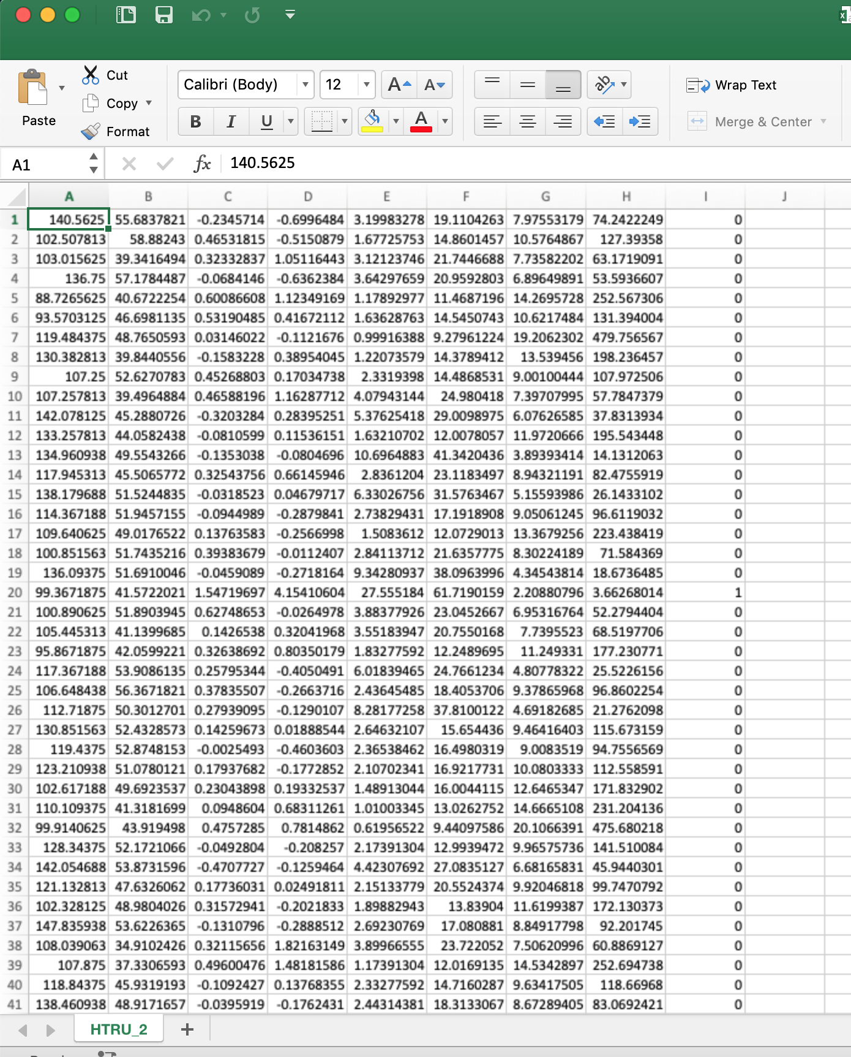
Like this

Slide 36
data.frame
htru2_df = read.csv(here("Data_Analyses_MATH_208/Datasets/HTRU2/HTRU_2.csv"), header=FALSE) class(htru2_df)
[1] "data.frame"
head(htru2_df)
V1 V2 V3 V4 V5 V6 V7 1 140.56250 55.68378 -0.23457141 -0.6996484 3.199833 19.11043 7.975532 2 102.50781 58.88243 0.46531815 -0.5150879 1.677258 14.86015 10.576487 3 103.01562 39.34165 0.32332837 1.0511644 3.121237 21.74467 7.735822 4 136.75000 57.17845 -0.06841464 -0.6362384 3.642977 20.95928 6.896499 5 88.72656 40.67223 0.60086608 1.1234917 1.178930 11.46872 14.269573 6 93.57031 46.69811 0.53190485 0.4167211 1.636288 14.54507 10.621748 V8 V9 1 74.24222 0 2 127.39358 0 3 63.17191 0 4 53.59366 0 5 252.56731 0 6 131.39400 0

Slide 37
tibble
library(tidyverse) htru2_tbl = read_csv(here("Data_Analyses_MATH_208/Datasets/HTRU2/HTRU_2.csv"), col_names =FALSE) class(htru2_tbl)
[1] "spec_tbl_df" "tbl_df" "tbl" "data.frame"

Slide 38
tibble vs. data.frame
htru2_tbl
# A tibble: 17,898 x 9 X1 X2 X3 X4 X5 X6 X7 X8 X9 <dbl> <dbl> <dbl> <dbl> <dbl> <dbl> <dbl> <dbl> <dbl> 1 141. 55.7 -0.235 -0.700 3.20 19.1 7.98 74.2 0 2 103. 58.9 0.465 -0.515 1.68 14.9 10.6 127. 0 3 103. 39.3 0.323 1.05 3.12 21.7 7.74 63.2 0 4 137. 57.2 -0.0684 -0.636 3.64 21.0 6.90 53.6 0 5 88.7 40.7 0.601 1.12 1.18 11.5 14.3 253. 0 6 93.6 46.7 0.532 0.417 1.64 14.5 10.6 131. 0 7 119. 48.8 0.0315 -0.112 0.999 9.28 19.2 480. 0 8 130. 39.8 -0.158 0.390 1.22 14.4 13.5 198. 0 9 107. 52.6 0.453 0.170 2.33 14.5 9.00 108. 0 10 107. 39.5 0.466 1.16 4.08 25.0 7.40 57.8 0 # … with 17,888 more rows

Slide 39
tibble vs. data.frame (cont.)
head(as.data.frame(htru2_tbl))
X1 X2 X3 X4 X5 X6 X7 1 140.56250 55.68378 -0.23457141 -0.6996484 3.199833 19.11043 7.975532 2 102.50781 58.88243 0.46531815 -0.5150879 1.677258 14.86015 10.576487 3 103.01562 39.34165 0.32332837 1.0511644 3.121237 21.74467 7.735822 4 136.75000 57.17845 -0.06841464 -0.6362384 3.642977 20.95928 6.896499 5 88.72656 40.67223 0.60086608 1.1234917 1.178930 11.46872 14.269573 6 93.57031 46.69811 0.53190485 0.4167211 1.636288 14.54507 10.621748 X8 X9 1 74.24222 0 2 127.39358 0 3 63.17191 0 4 53.59366 0 5 252.56731 0 6 131.39400 0

Slide 40
tibble vs. data.frame, Round 2
mymcgill_stats_tbl = tibble(Courses=list(U1=U1,U2=U2,U3=U3), Year = c("U1","U2","U3"), Major = rep("Statistics Major",3)) mymcgill_stats_tbl
# A tibble: 3 x 3 Courses Year Major <list> <chr> <chr> 1 <dbl [2]> U1 Statistics Major 2 <dbl [3]> U2 Statistics Major 3 <dbl [5]> U3 Statistics Major

Slide 41
Back to HTRU2
names(attributes(htru2_tbl))
[1] "names" "class" "row.names" "spec"
attributes(htru2_tbl)$names
[1] "X1" "X2" "X3" "X4" "X5" "X6" "X7" "X8" "X9"
names(htru2_tbl)= c("Mean_IP", "SD_IP", "EK_IP", "SKW_IP", "Mean_DMSNR", "SD_DMSNR", "EK_DMSNR", "SKW_DMSNR", "Class") htru2_tbl
# A tibble: 17,898 x 9 Mean_IP SD_IP EK_IP SKW_IP Mean_DMSNR SD_DMSNR EK_DMSNR SKW_DMSNR <dbl> <dbl> <dbl> <dbl> <dbl> <dbl> <dbl> <dbl> 1 141. 55.7 -0.235 -0.700 3.20 19.1 7.98 74.2 2 103. 58.9 0.465 -0.515 1.68 14.9 10.6 127. 3 103. 39.3 0.323 1.05 3.12 21.7 7.74 63.2 4 137. 57.2 -0.0684 -0.636 3.64 21.0 6.90 53.6 5 88.7 40.7 0.601 1.12 1.18 11.5 14.3 253. 6 93.6 46.7 0.532 0.417 1.64 14.5 10.6 131. 7 119. 48.8 0.0315 -0.112 0.999 9.28 19.2 480. 8 130. 39.8 -0.158 0.390 1.22 14.4 13.5 198. 9 107. 52.6 0.453 0.170 2.33 14.5 9.00 108. 10 107. 39.5 0.466 1.16 4.08 25.0 7.40 57.8 # … with 17,888 more rows, and 1 more variable: Class <dbl>

